Slide 1
Agenda
Key Communicators Meeting / 02.06.19
General Updates / Sharon
Day of Giving Review / Garrett Cullen
WVU Research Week / Ann Claycomb & Melanie Page
WV Forward Website / Katie Farmer
Career Messaging / Patrick Gregg
Rounds

Slide 2
creative inspiration

Slide 3
Notes:
This is the kind of sledding I like to watch…

Slide 4
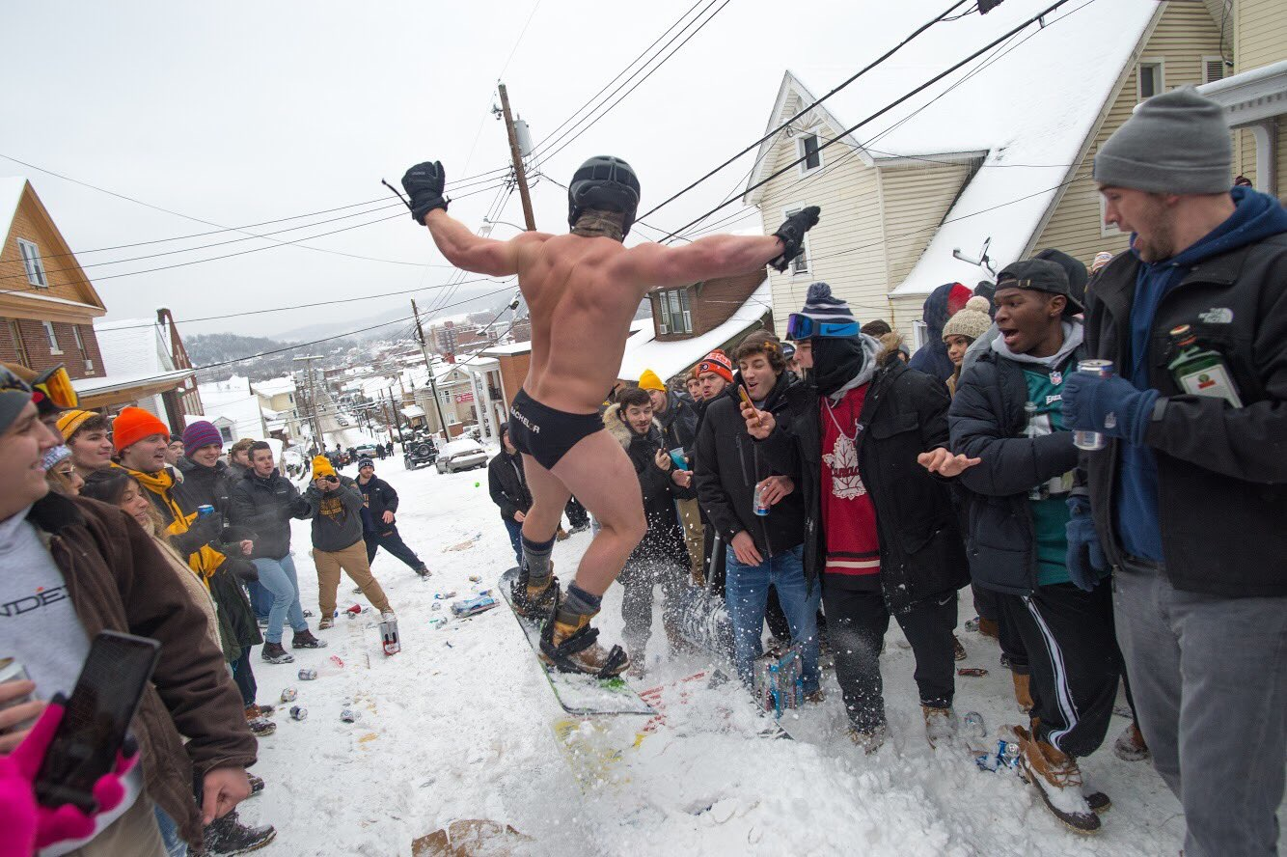
Notes:
Not this.

Slide 5
Spruce Street
• Incident between around 300 students and police
• Talking points distributed
• Media attention (local, regional and national)
• Committee meeting Friday afternoon to review next steps
• Will have a follow-up statement in the future

Slide 6
Strategic Transformation Team
• Led by Joyce McConnell, Maryanne Reed and Melissa Latimer
• Team from around the University charged with bringing innovative ideas to fuel the future of the institution
• Meeting bi-weekly through May
• Teams will be leading working sessions with colleges and schools
• Seeking input from all constituents
• Final plan to be shared by Dr. Gee at his Spring 2020 SOU

Slide 7
Dates for your calendar
• February 8 – BOG meeting
• February 18 – Distinguished Scholars
• February 27 – Key Communicators Workshop: Executive Comm Strategy
• March 19 – Spring State of the University
• March 23 – Decide WVU
• March 27 – Mini-Workshop: Leveraging Your Leaders on Social
• April 12 – BOG meeting
• April 13 – Decide WVU

Slide 8
Key Communicators Workshop
Executive Communication Strategy
Wednesday, Feb. 27 at Erickson Alumni Center – 1:30 to 4:45 p.m.
How to leverage your leaders with all the tools in your toolkit including:
how to find your leader’s authentic voice
speechwriting and talking points
social media
op-eds
public appearanceslevels, etc.

Slide 9
Key Communicators Mini-Workshop
Executive Communication: Leveraging Your Leaders on Social
Wednesday, March 27 at Erickson Alumni Center – 2:30-4:30 p.m.
25-person capacity
In-depth look at how to use social to your leader’s advantage

Slide 10
Legislative update
• Legislative team continues to monitor the Campus Carry bill
• Also monitoring the K-12 legislation
• Under the Dome out today
• Reminder: alert Travis Mollohan if anyone is headed to the Capitol

Slide 11
Boy Scouts of America partnership
World Jamboree – held at the Bechtel Summit beginning July 22
• WVU will be there with Science behind the Sports, medical volunteers and leading teams throughout the week
• Recruitment and marketing opportunity
Science Adventure School – Summer 2019
• Hosting more than 500 middle school students in a 4-week span at the Summit

Slide 12
Boy Scouts of America partnership
Degree Programs
• Organizational Leadership – Business & Economics
• Adventure Recreation Management – WVU Beckley
• Will be co-branding with the BSA to market to and recruit students interested in those programs, as well as other programs
• Visiting 25 councils that align with our core markets
• Creating a mar/comm plan, recruitment plan to support effort

Slide 13
Recruitment stats (as of Jan. 31)
Applications -3.1%
Admits +1.8%
Deposits +18.4%
Housing deposits +36%
Melt -14
Academic profile AI 1, 2 & 3 up by 213

Slide 14
Spring Yield plans
Ask Us Anything
• Events happening this week in NY and NJ
• In three days, meeting with nearly 100 students and their families
• On Thursday, hosting Camp WVU for guidance counselors in NJ
• Additional AUA day in Columbus in March
Decide WVU Days
• Saturday, March 23
• Saturday, April 13

Slide 15
Spring Yield plans
Additional efforts
• Student Call Center
• Distinguished Scholars
• Recognizing incoming freshmen (grad cards, birthday cards)
• College/School outreach

Slide 16
ACM messaging
• ACM will no longer be offered beginning with the Summer 2020 class
• Only 2% of our student population participate
• Current students will not be affected
• Ohio Reciprocity will not be affected
• Discontinuing will allow students greater opportunities both academically and financially
• Talking Points and FAQs have been distributed

Slide 17
Culture Survey
• Culture survey results have come back
• Talent & Culture are meeting with VPs and Deans to review
• Overall, we are seeing the needle move in the right direction
• Will be taking a break to allow leaders to implement changes
• Campus Conversations
• March 8 – 1 pm at HSC (location TBD)
• March 11 – 11 am (Law Event Center)
• March 12 – Noon – Lair Gold Ballroom (webcast)

Slide 18
Next up
• Garrett / Day of Giving Review
• Ann & Melanie / Research Week
• Katie / WV Forward Website
• Patrick / Career Messaging
• From the Floor

