Slide 1
Enrollment Update

Slide 2
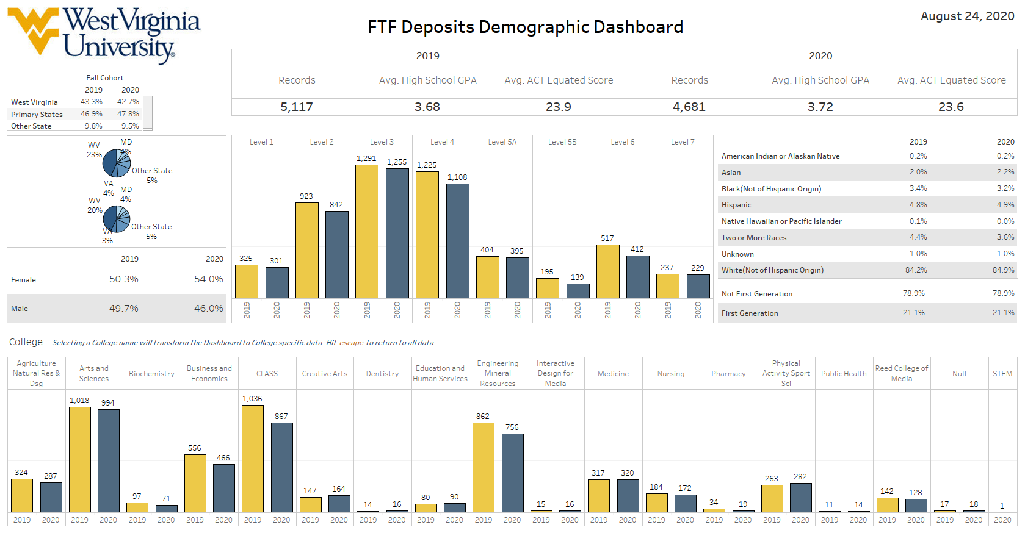
Notes:
FTF Quality remains strong as compared to last year
Headcount is down overall but we maintained enrollment under the curve in AI 3 and 4. These students graduate and retain well while not bringing down academic profile
Enrolled students are currently at 4559 that number may increase going into the first day of classes with last minute admits and students registering in the next few days
FTT numbers are following a similar trend to FTF. We are down 141 students (744 vs 503)

Slide 3
National Trends
Students are rethinking how far they are willing to travel to attend an institution
The sudden shut down of campuses in the spring has not been forgotten by students searching for colleges this fall
There is a desire to be close to home in case anything will happen during their time at school
Decision factors for choosing a college have shifted but been completely changed

Slide 4
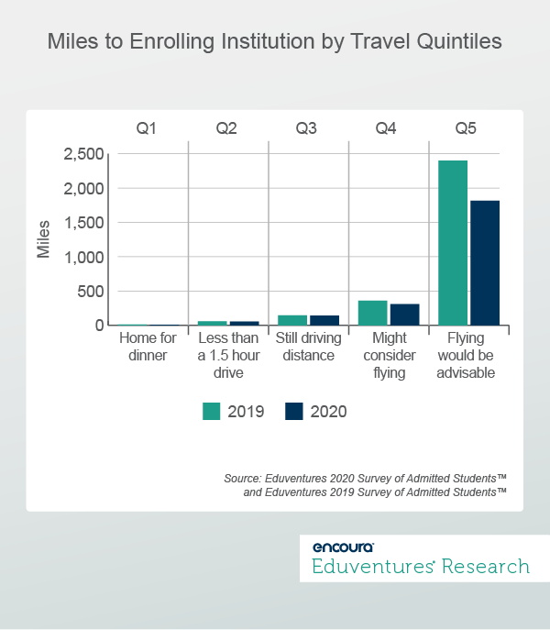
Students are less willing to travel overall
If plane travel is required due to distance the impact is higher
Schools will be refocusing recruitment efforts in their primary markets

Slide 5
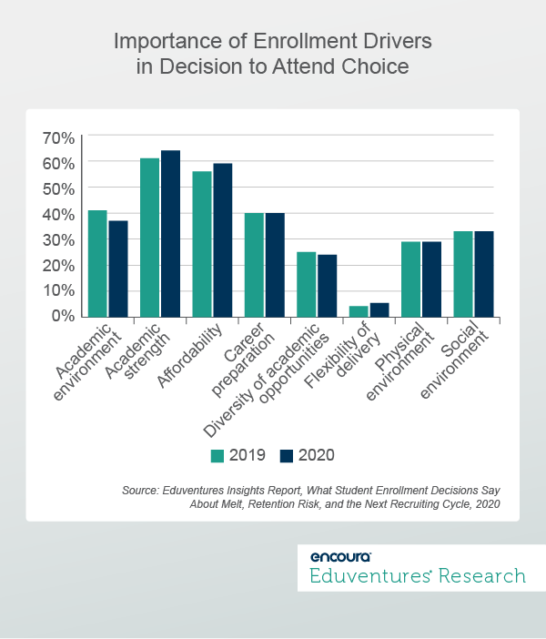
Areas of importance such as affordability and academic quality remain important decision drivers
The academic environment changed and more students are looking at flexibility in delivery than before
Students are considering how online instruction will impact their academic experience

Slide 6
Admissions Changes
Test Optional Admissions have been adopted for the next year as a response to COVID 19
Test optional applicants will be considered for merit aid and final program details are being developed
Guided Pathways program in CLASS will be implemented this fall. This will eliminate pre-majors in CLASS
Notes:
Schools and colleges have included test optional paths where applicable. If Math placement is required for a specific track students will have other options to complete that step post admissions. ALEKS, TEAS (Nursing), AP, IB, Dual enrollment
Merit strategy is in final approvals for test optional applicants. The strategy will be system wide just like the SOD program currently in place
Guided pathways (meta-majors) was a program launched by the Provost’s office as part of the Complete College America program. It provides students that do not meet their major requirements on admissions with the abiltiiy to se what courses they need to complete in order to achieve their original goal and also how other majors that are related may be a better fit. This ties in well with the Pathway marketing we have been providing to students for the past 2 years in Marketing comms.

Slide 7
Fall Communications
Encourage app emails
Application opened on August 1st
App fee waiver postcard
Identified new populations to receive fee waivers
Viewbook mailing
Digital marketing plans
Notes:
Application is open for Fall 2021
Communicating to students about applying

Slide 8
Fall Recruitment
Many college fairs are going virtual for the fall
Participated in a number of regional and national fairs virtually
Additional virtual opportunities will be provided to students directly
AUAs, Discover, Meet WVU, VC programing, etc

Slide 9
Graduate Admissions
Graduate admissions is seeing continued growth in enrollment numbers
Inbound marketing has contributed to the application growth and interest in WVU
Welcome Erin Fields as a new program coordinator
Target X application roll out is complete
Transitioned SOM away from a paper application to and are in the process of finally moving Dentistry to Target X
Notes:
We are pleased to continue to see positive growth in our enrollment numbers. (Apps up 60: 1.4% Admits up 160: 7.3%) Our team has done an outstanding job of serving the colleges and applicants while working from home and during a major transition to a new application system! Our inbound marketing recruitment strategies are proving successful with more applicants, admits and enrolled graduate students this Fall!
Welcome to Erin Fields who has joined our team as our Program Coordinator. Erin will primarily focus on our marketing and recruitment projects. She will be heavily involved in our social and digital marketing efforts.
The transition to TargetX is now complete. Since November of 2018 we have successfully rolled out the application, the application review tool (ART) and CRM. Many thanks to our wonderful Enrollment Technology Unit who made this transition happen. We were fortunate to work with so many talented and dedicated people.
We also successfully launched an online version of the School of Medicine’s summer remedial course application that was previously a paper application mailed with a check for the application fee. We are also in the midst of transitioning the School of Dentistry away from a paper application to TargetX. Thanks to Josh and the Enrollment Technology Group for making the online application and online payment of the application fee a reality.

Slide 10
Questions?

