Slide 1
NEWS COVERAGE SUCCESS

Slide 2
RETURN TO CAMPUS PLANS
WVU’s RTC plans have generated local, state, regional and national news attention.

Slide 3
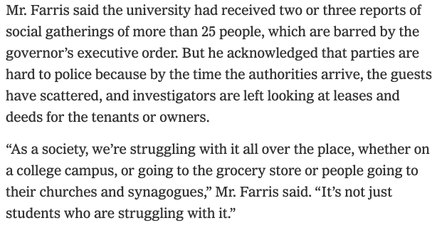
RETURN TO CAMPUS PLANS
Dean of Students Corey Farris was quoted:

Slide 4
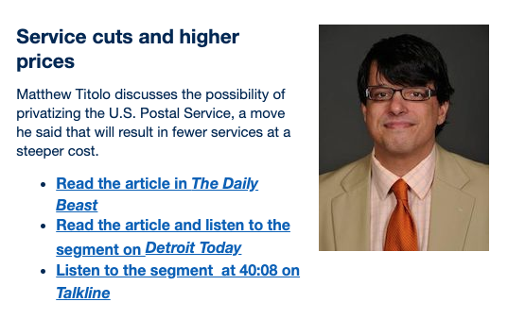
RESEARCH MAKING NEWS

Slide 5
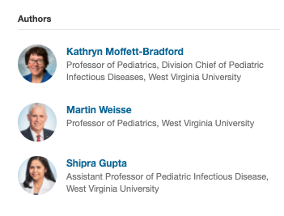
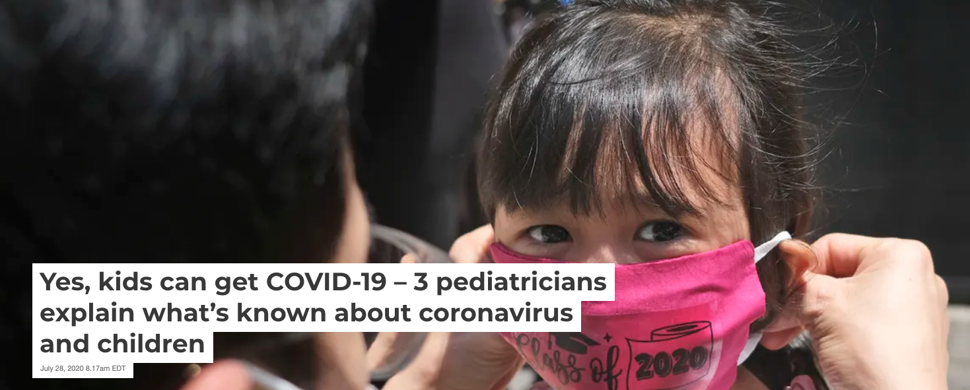
THE CONVERSATION
Our partnership with The Conversation continues to provide a national platform for WVU.

Slide 6
‘INSIDE WVU TODAY’ RETURNS

Slide 7
STAY UP-TO-DATE ON THE NEWS
wvutoday.wvu.edu
enews.wvu.edu and daily MOUNTAINEER E-News email
WVUWeekly emails on Monday afternoons
students.wvu.edu and daily Unews email for students

