Slide 1
Enrollment Management Update
Stephen Lee
Associate Vice President for Enrollment Management

Slide 2
Morgantown FTF Compared to 2018
 | Applications | +/- | Admits | +/- | Deposits | +/-
Resident | 3,306 | -84 | 2,810 | 1 | 1,677 | 85
Non-Resident | 13,070 | -600 | 10,597 | 88 | 2,035 | 427
International | 437 | 13 | 295 | 12 | 11 | 2
Diversity | 3,744 | -513 | 2,493 | -60 | 390 | 52

Slide 3
Morgantown FTT Compared to 2018
 | Applications | +/- | Admits | +/- | Deposits | +/-
Resident | 217 | -37 | 92 | -15 | 49 | 7
Non-Resident | 522 | -58 | 233 | -49 | 55 | -6
International | 157 | 94 | 29 | -9 | 3 | -2
Diversity | 107 | -42 | 48 | -12 | 14 | 2

Slide 4
Morgantown FTG Compared to 2018
 | Applications | +/- | Admits | +/-
Resident | 446 | -42 | 174 | 36
Non-Resident | 1,303 | -140 | 255 | 14
International | 777 | -72 | 109 | -28

Slide 5
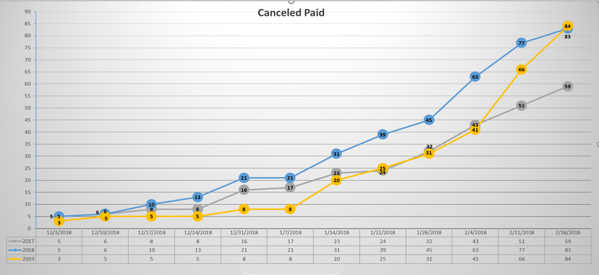

Slide 6
Financial Aid Awarding: FTF and FTT (2/5/19)
 | Offered Awards | Total $ Offered | Accepted Awards | Total $ Accepted
Fall 2019 | 17,651 | $95,895,768 | 3,623 | $18,099,434
Fall 2018 | 12,560 | $73,177,391 | 2,139 | $10,150,377
Final Fall 2018 | 15,450 | $85,122,230 | 5,307 | $22,903,353

Slide 7
The Homestretch: Yield and Anti-Melt
Distinguished Scholars – 128 students attended
March Decide Day (open house) – 485 students registered
April Decide Day (open house) – 200 students registered
AUA – Columbus, Southern WV
Graduate Recruitment Fair on campus
Student ambassador and regional recruiter outreach
Financial Aid Planners will be distributed
Communication Plan - print, email, social
Regional campuses will be using Target X
NSO registration is live on February 25!

