Slide 1
PITCH PERFECT How to find, develop and optimize your stories

Slide 2
WHAT MAKES A GOOD IDEA?
Does it support WVU areas of emphasis? (Education, Healthcare and/or Prosperity)
Does it support your college/unit areas of emphasis?
Does it affect a key WVU or college/unit audience? (Prospective students, their parents, alumni/donors or other decision makers)
Does it include compelling or unique elements? (A lot of money, good visuals, WV connection, human interest, etc.)

Slide 3
HOW DO YOU FIND GOOD IDEAS?
Relationships with faculty, staff, students and constituents
Listening for the good idea (HINT: It’s often the impromptu comment made during a conversation on another topic.)
Topical events or public issues & trends (In other words: What people and media are talking about.)
Personal observations
Peer institutions

Slide 4
HOW DO YOU CULTIVATE A STORY-RICH ENVIRONMENT?
Work your beat: Be engaged and show interest Take advantage of existing meetings and gatherings
Identify sources within your college/unit and points of contact Look for those who are “plugged in”
Proof of performance Reinforce the value of what you’re doing by sharing examples
REPEAT – REPEAT - REPEAT

Slide 5
WHAT DO YOU DO WITH YOUR GOOD IDEAS? (1/2)
Consider what formats may work best:
Video Photos Traditional news release Media Advisory Opinion/Editorial or other written presentation Media Pitch

Slide 6
WHAT DO YOU DO WITH YOUR GOOD IDEAS? (2/2)
Consider what platforms or vehicles may be most effective:
Listservs, electronic newsletters and magazines Traditional news releases Event (news conference, media availability, etc.) Websites (your own or others) Social media channels (your own or others)

Slide 7
HOW CAN UR HELP?
Strategize formats and distribution
Assist with editing or writing
Distribute content or help you build your own media distribution list
Make media pitches
Arrange news conferences, interviews and satellite uplinks
Provide media training (including communicating research)

Slide 8
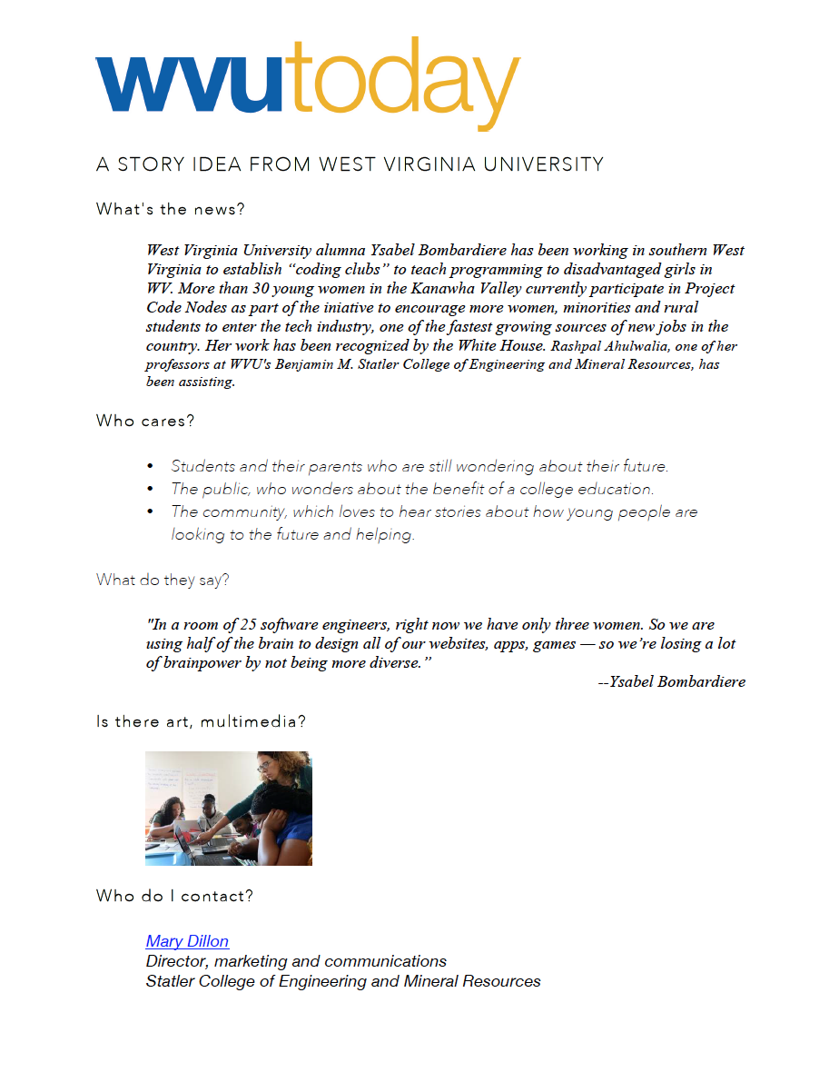
MEDIA PITCH
Currently in development
Based on feedback from reporters
Does not replace media advisories or news releases

Slide 9
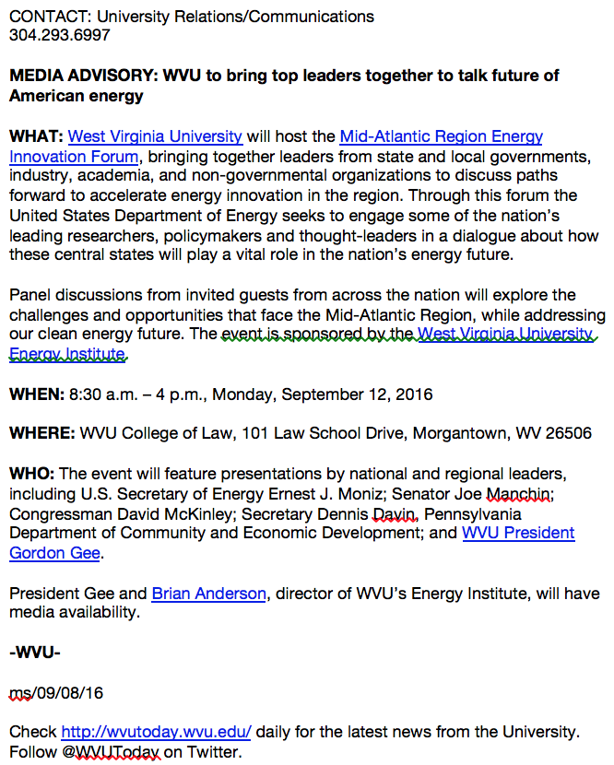
MEDIA ADVISORY
Basic details
Targets media to encourage event coverage
Does not provide elements such as video, audio or photos

Slide 10
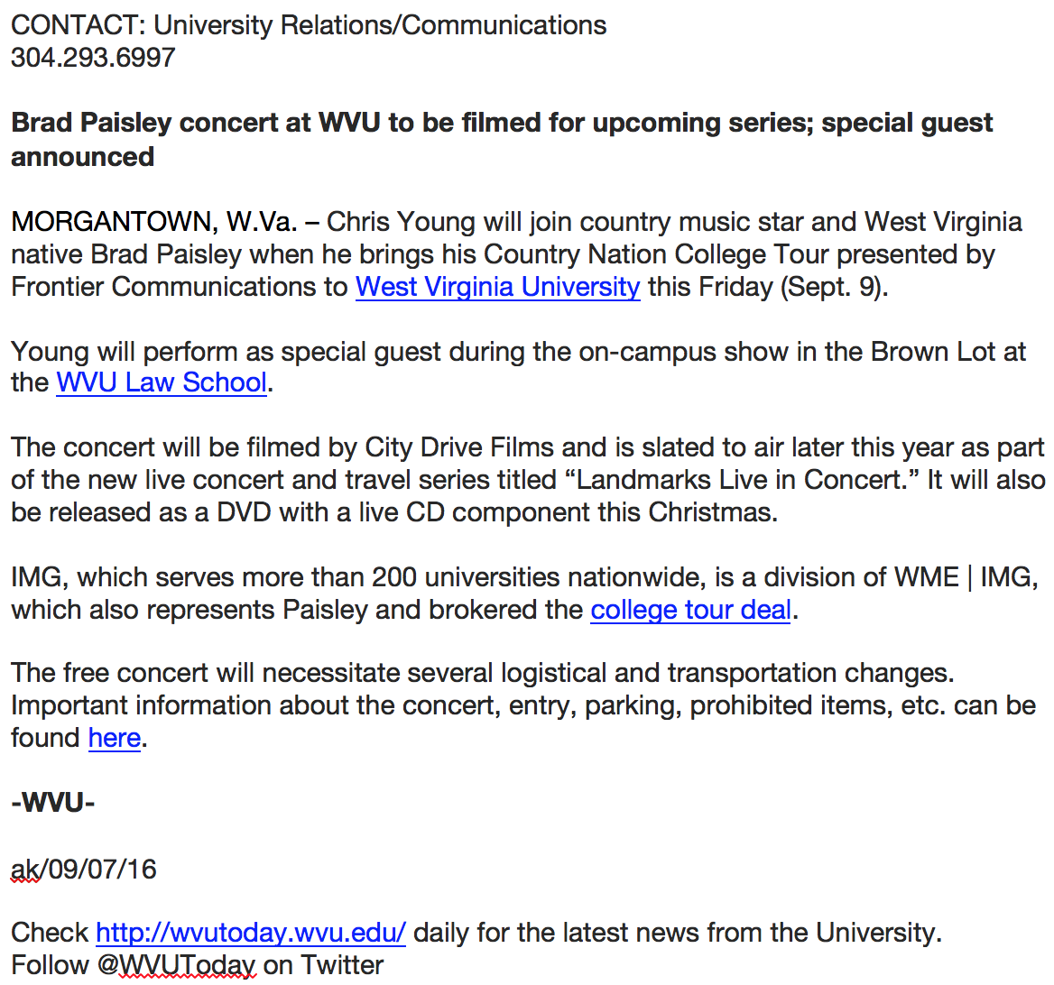
NEWS RELEASE
Written as a complete story
Focused with priority audience in mind
Reserved for areas of emphasis, etc.

Slide 11
MEDIA TOOL KITS
Example: Dan Carder/TIME 100
http://go.wvu.edu/210cTs4

Slide 12
UR PLATFORMS: EXTERNAL
Selected communications that align with the University’s primary messaging goals are posted to WVU Today - a website that is primarily designed as a media resource. (This website is undergoing a redesign.)
The items posted to WVU Today are sometimes shared individually with media via an email distribution system. Additionally, all are shared via a daily email called the West Virginia University News Digest.

Slide 13
UR PLATFORMS: INTERNAL
Mountaineer ENEWS is distributed at 9 a.m. Monday through Friday primarily to faculty and staff on all campuses. This email publication contains news and announcements about the University (and is also undergoing a redesign). Additional guidelines may be found at: http://universityrelations.wvu.edu/communications/enews-guidelines
For content questions, contact April Kaull at 304.293.3990. To submit an item to Mountaineer ENEWS, use the form at: http://universityrelations.wvu.edu/communications/submit-enews

Slide 14
UR PLATFORMS: INTERNAL (cont.)
UR/Communications also publishes and distributes WVU Weekly each Monday at 1 p.m.
This email publication contains a high-level communications, a review of the past week, topics related to higher education, a preview of upcoming events and media mentions of WVU in the past week.

Slide 15
UNIVERSITY RELATIONS/COMMUNICATIONS Helpful Writing Tips (1/4)
Goal
What do you want this story to do? Point to an outcome in line with the University’s goals. If you’re looking for donors, make it about something that inspires gift giving. If you want students to enroll, give them a reason to enroll. And make it a reason that would encourage you to enroll at WVU.
Focus
What’s the story really about? On the surface, it may be about a student who wants to cure Alzheimer’s, but what it’s really about is a granddaughter’s inspiration and desire to make life better for others. Or it may be about a grant to produce a documentary on research, but what it’s really about is finding and training the next generation of scientists.

Slide 16
UNIVERSITY RELATIONS/COMMUNICATIONS Helpful Writing Tips (2/4)
Audience
Remember, not everyone reading this is familiar with your college, your research, your awards or even WVU. Always be mindful of the story’s audience, which could be the general public, prospective students, alumni, prospective faculty, donors or any combination of these. The telling of the story will change based on the target. Even if the person you’re interviewing describes it in complicated and/or scientific terms, it’s your job to write the story in a manner that will be easily understood. Refrain from pulling sentences and/or phrases from Wikipedia or other websites to clarify information – put it in layman’s terms.
Grants
Many of the story ideas that cross your desk involve the receipt of a grant. Rarely is the grant, or its dollar amount the news. The news in any grant story is what can be done with the money that is interesting, innovative, beneficial and/or unique. Unless an award is the largest ever received, the dollar amount should rarely be in the introductory paragraphs of a story. Even if it’s a large dollar amount, the scope and importance of the project usually outweighs the significance of the dollar amount.

Slide 17
UNIVERSITY RELATIONS/COMMUNICATIONS Helpful Writing Tips (3/4)
Awards
Faculty and student awards are chances to showcase the work done in your department or college. These stories give you a chance to put the everyday work of your unit under a news spotlight. Don’t merely list the award, a “happy and thrilled” quote, background on the recipient and background on the awarding organization. Tell the story of the person and their research or their scholarship.
Acronyms
When asking yourself if you should insert an acronym into your story, the answer is “probably not.” Certain instantly recognizable acronyms are allowed on first reference, including FBI and CIA. But generally, write out the name of the organization on first reference, and use the acronym on second and subsequent references. Do not put the acronym in parenthesis following the first reference. If the acronym can’t be understood in context on subsequent references, do not use it at all.
West Virginia University
West Virginia University must be spelled out on first reference and thereafter written as WVU. The institution is also known as the University on second reference.

Slide 18
UNIVERSITY RELATIONS/COMMUNICATIONS Helpful Writing Tips (4/4)
Hyperlinks
Every story must have hyperlinks to internal WVU Web pages. Link to the WVU homepage, the colleges or schools mentioned in the story, any professors or WVU individuals who have WVU page and are pertinent to the story. As a rule, do not link to outside organizations. A few exceptions include links to event sign-ups hosted on other sites and sparing use of links to artist work if used to attract visitors to a WVU event.
Due to the importance of links, the tagline must be used on all WVU stories exactly as shown here:
Check http://wvutoday.wvu.edu daily for the latest news from the University. Follow @WVUToday on Twitter.
Photos EVERY release should be accompanied by a photo(s) or art (graphic, etc.). If you are not sure about what is appropriate – just ask and UR/Communications can help.
Style
When creating releases, please use the Associated Press Stylebook, the world’s standard for media writing.

Slide 19
IT’S ALL ABOUT RELATIONSHIPS
Remember that the media define what the "news" is. The best chance of placement success comes from having a good story to tell in the first place -not by force-feeding good news to media outlets.
Be accessible and reliable. Get to know the reporters who cover stories in your area of expertise. That way, when you want to pitch them a story or do damage control, your motives aren't suspect.
When conducting an interview, know the reporter's audience. That helps define your message points. Ask about deadlines before you start speaking; find out how they prefer to be communicated with - in person, on phone, email; let them know you appreciate their efforts - but don't thank them for "good publicity." Thank them for bringing an important story to the public's attention.
Treat reporters how you would like to be treated. Be positive; don't get caught up in negativity - even if they are surly and rude. Stick to the facts and the issues. They might try to push your buttons, but just stay calm and focused. Remember that you are not only representing yourself, but WVU and the State.
Tell the truth. Keep it simple. You are not obligated to tell all that you know, but what you do say must be accurate and truthful.
If you don't know the answer, tell the reporter that - but that you will try to research it quickly and get back to them. If they bring up untruths or facts that you aren't familiar with, it's fine to say, "I don't know that to be true, but here's what I do know."
You do have the right to decline an Interview, and In some cases, that's wise. For example, if a reporter is targeting an Individual regarding a personnel issue, then he or she could politely refer them to a third party - an attorney or a University spokesperson. But don't say "no comment." It can sometimes imply guilt or that you have something to hide. I usually say, "I can't talk about that because it's in litigation, but if I can help you on another matter I will."
You are always on the record when in the presence of a reporter, whether that is in person or on the phone or by email. So, if you aren't comfortable saying something, don’t.
Be brief. Short, concise answers are usually best, especially for TV and radio purposes. Have your three key messages in mind and deliver them. If a reporter doesn't ask you something that you want to point out, then offer that information at the end. "Oh, just one more thing I thought was important to this story."

Slide 20
THE ESSENTIAL “C”s
COMPELLING - What about your research/event/issue will make people want to watch/read or listen (How will it affect the audience? Human element? Visual elements?)
CLEAR - A story, no matter how big or small, must be clear and easy to understand immediately. (Remember that most audiences are multitasking and will only get one opportunity to experience your story).
CONCISE - A story should not include unnecessary elements or anything that dilutes the effectiveness of the report. Work to hone your writing/message to the essentials. It will help you stay on target and keep you story focused. I suggest boiling your entire research/event/issue down to two sentences.
CONVERSATIONAL - Use informal language during interviews. Avoid technical terms that the average person won't understand. If it's unavoidable - then look for an everyday analogy you can use to make it more relatable.
COMPLETE - Think like someone who knows nothing about your
event/issue/research. What would you want to know, see or hear? Plan to have props, people or information readily available to address those BEFORE going public.
COMMUNICATE - Never assume someone else knows. Over-communicate anything you're working on - that may be of public interest. Once that happens, if you've followed the first five "C"s then you'll be in the best position for effective communication to the public and media. Remember to follow through EARLY ON with your key communicator, department chair or dean as appropriate. University Relations/News is here to assist and help leverage attention and reach.

Slide 21
FOR MORE INFORMATION: UNIVERSITYRELATIONS.WVU.EDU/COMMUNICATIONS

